Slide 1


Abstra
Lazar Milicevic
Weekly support report
Support, Challenges, Sollutions
25.02.2024

Slide 2
Agenda
1. Key Updates
3. Technical Support & Process Improvements
5. Canny & SurveySparrow Evaluations
7. Q&A
2. Hackathon Support
4. Zendesk Ticket Management & Weekly Rotation
6. Challenges & Solutions

Slide 3
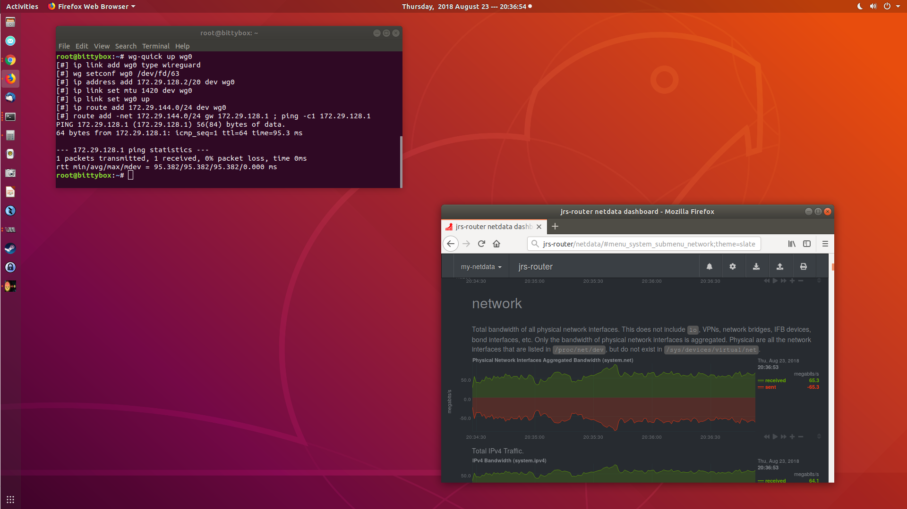
Key Updates
Customer success: Weekly Support Report – 25.02.2025
What was done:
📌 Hackathon User Support & Technical Assistance
Assisted hackathon users with Abstra access, VPN setup, and login troubleshooting.
Assigned project permissions and resolved access-related technical issues.
Conducted individual and group support sessions to ensure smooth onboarding. Resolved Jean Radig’s Astra platform access issue caused by an IP change.
Requested and provided a WireGuard configuration to ensure stable access.
📌 Zendesk Ticket Management & L2
Taking ownership of L2 ticket handling, progressively working more cases independently.
Prioritized responding to tickets within the first 15 minutes of arrival.
Scheduled a knowledge-sharing session with Guilhem from the L2 Research Team to improve troubleshooting efficiency.
📌 Process Improvements & Tool Evaluations
Reviewed and optimized Zendesk ticket routing and backlog clearing.
Tested SurveySparrow for embedding an NPS feedback widget into Owkin K.
Researched and prepared a presentation on Canny for structured feature request management.

Slide 4
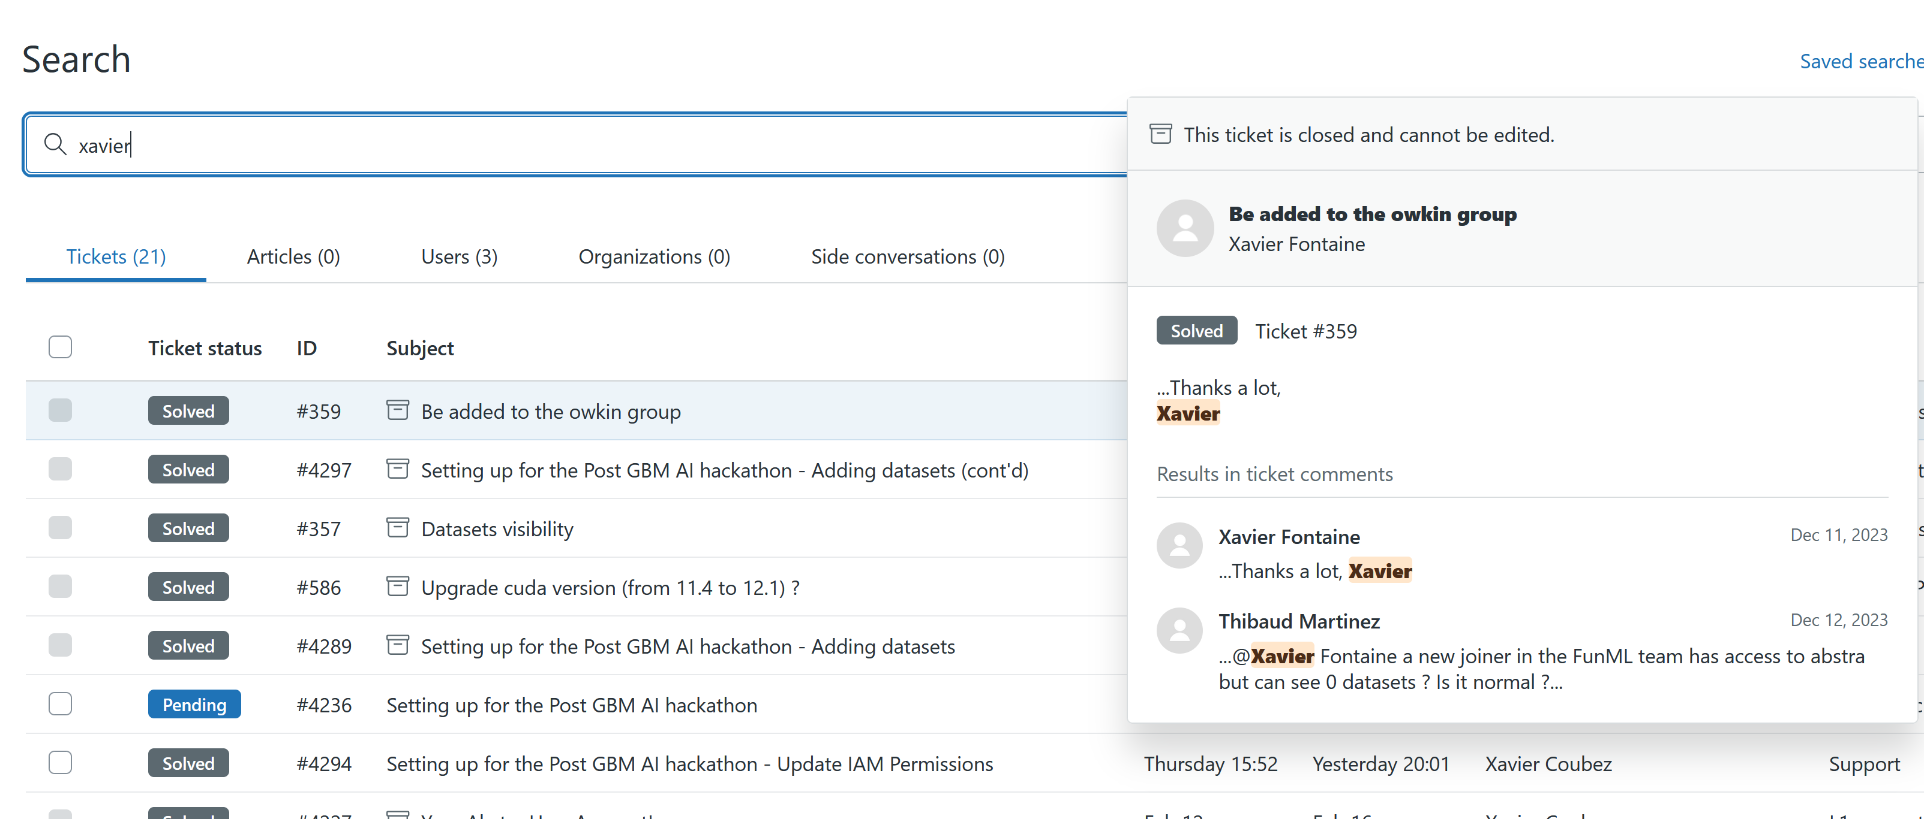
Hackathon Support
Customer success: Weekly Support Report – 25.02.2025
Hackathon User Support
Provided active support to hackathon users regarding Abstra access.
Assisted them in setting up WireGuard and logging into Abstra.
Assigned access rights to projects and resolved technical issues.
Conducted multiple group and individual support meetings to guide them through the process.

Slide 5
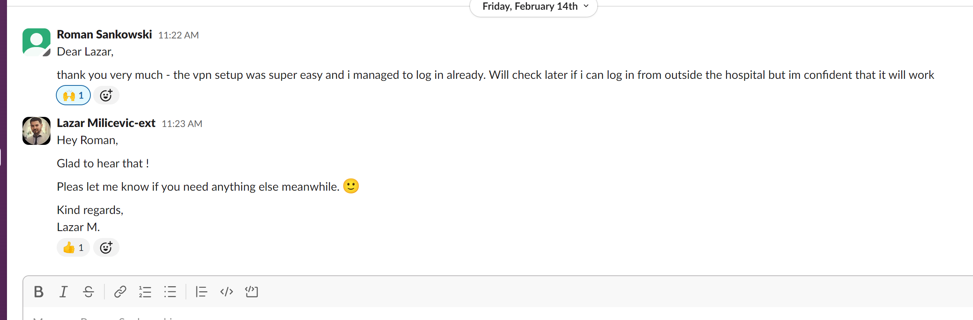
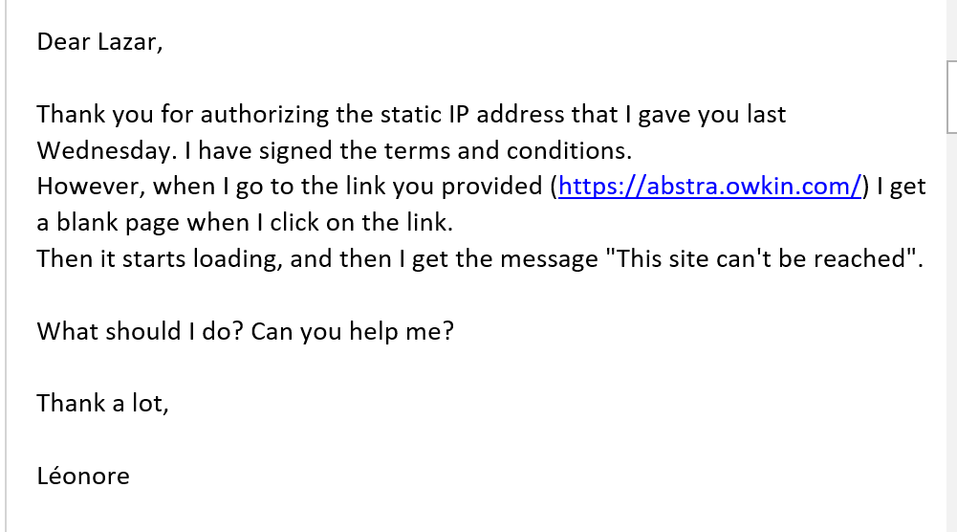
Technical Support & Process Improvements
Customer success: Weekly Support Report – 25.02.2025
Some of tasks completed:
WireGuard Configuration
Assisted Xavier Coubez with VPN access.
Requested and granted him a new WireGuard configuration.
VSCode Extension Issue (Valérie Ducret)
Investigated extension installation failure on two VMs.
Verified VSCode Server status, user permissions, and network connectivity
.
Reinstalled VSCode Server and followed up for resolution confirmation.

Slide 6
Zendesk Ticket Management & Weekly Rotation
Customer success: Weekly Support Report – 25.02.2025
What was done:
📌 Taking Ownership of Zendesk Ticket Processing
I have progressively taken on L2 ticket handling independently, improving my troubleshooting skills and response efficiency.
Prioritizing fast response times by striving to reply to tickets within the first 15 minutes of arrival.
📌 Notable Cases & Learnings
One of my first cases was troubleshooting VSCode extension failures on virtual machines (Valérie Ducret).
Verified VSCode Server functionality, checked user permissions, and performed a clean reinstall.
Followed up with Valérie to confirm the issue was resolved.
Other cases included AWS-related access issues, VPN troubleshooting, and system permissions adjustments.
📌 Collaboration & Growth
Scheduled a meeting with Guilhem from the L2 Research Team to review advanced tickets and ensure I can handle similar cases independently.
Gaining deeper insights into Zendesk workflows, best practices, and ticket escalation procedures.
Increasing confidence and efficiency in managing L2 support tasks on my own.

Slide 7
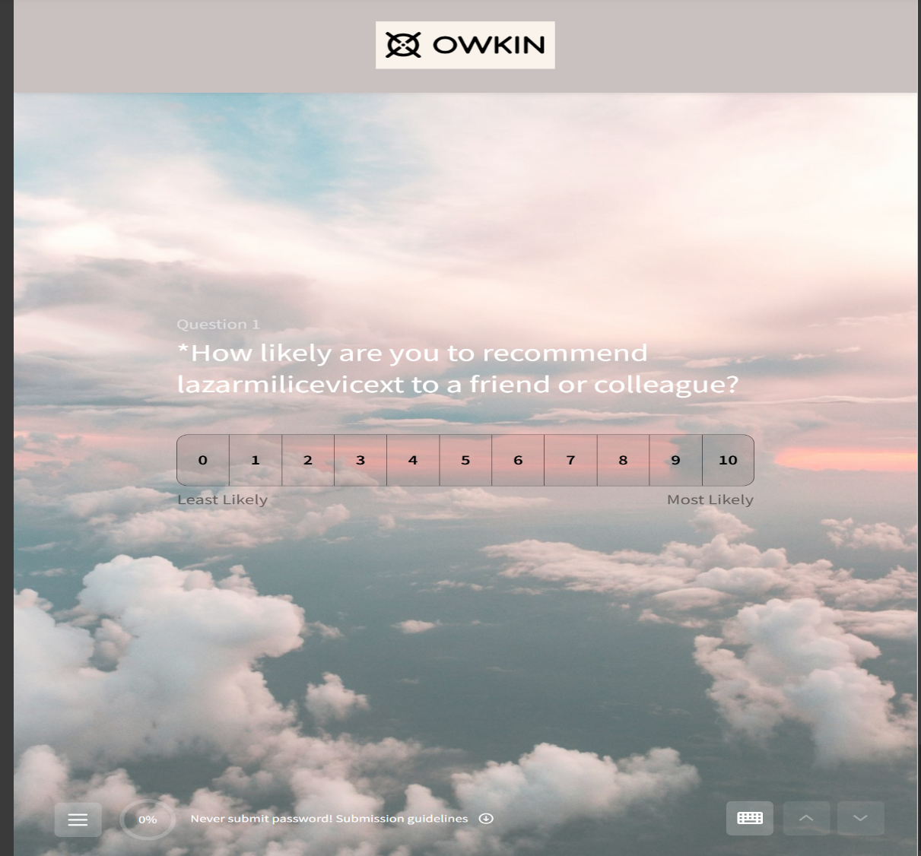
Canny & SurveySparrow Evaluations
Customer success: Weekly Support Report – 25.02.2025
What will be done:
SurveySparrow Testing & Evaluation
Tested SurveySparrow (28-day trial) for embedding an NPS widget into the Owkin K website.
Evaluated its potential for gathering structured feedback from users.
Canny Research & Implementation
Researched Canny as a feature request management tool for user voting and prioritization.
Drafted a structured presentation on Canny’s benefits and its integration with Abstra and Zendesk.
Discussed implementation possibilities with stakeholders.
Communication & Updates
Provided updates to stakeholders on process improvements and tool evaluations.

Slide 8
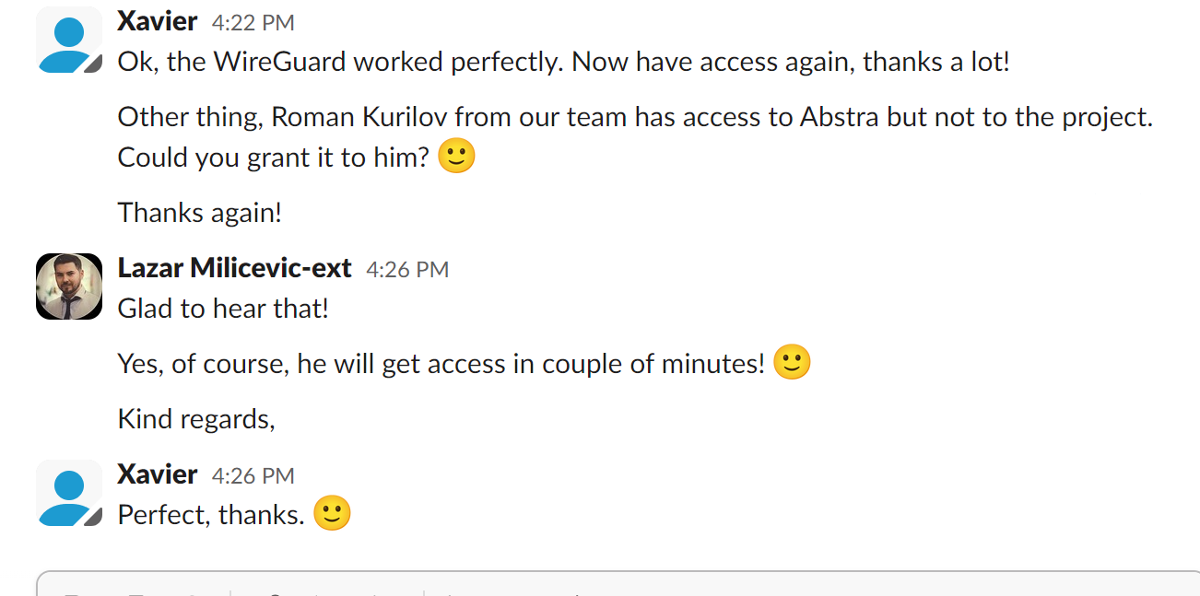
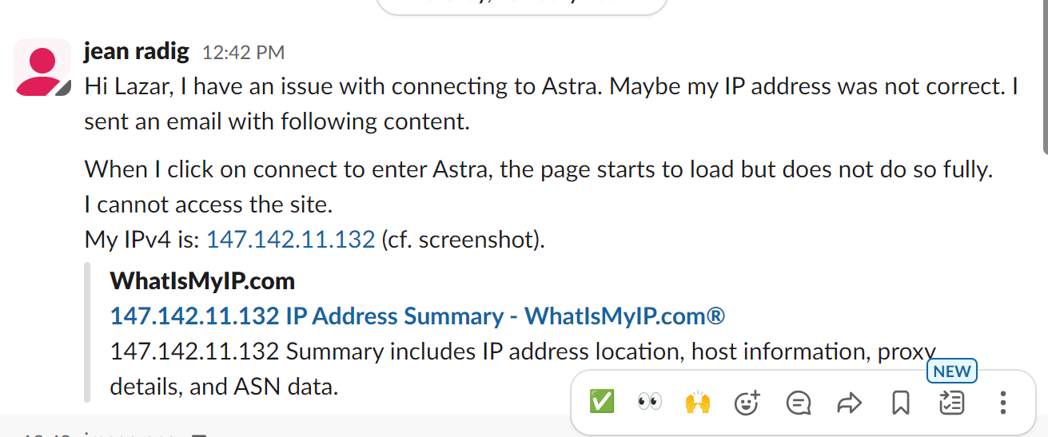
Challenges & Solutions
Customer success: Weekly Support Report – 25.02.2025
🔍 Issue: AWS Consumption Visibility
Lack of a clear overview of AWS consumption for hackathon teams. ✅ Solution: Communicated with Celine and forwarded a request to the Infrastructure team for a detailed consumption report.
🔍 Issue: IP Address Change Blocking Access
Jean Radig was unable to access the Astra platform due to an IP change. ✅ Solution: Identified the issue, informed him of the resolution, and requested a WireGuard configuration for stable access.
🔍 Issue: Hackathon Users Facing Access Problems
Hackathon participants struggled with Abstra access, VPN setup, and login issues. ✅ Solution: Provided direct assistance, guided them through WireGuard setup, assigned access rights, and held multiple support meetings.
🔍 Issue: VSCode Extension Failures on Virtual Machines
Valérie Ducret reported that VSCode extensions were not installing on certain VMs. ✅ Solution: Verified VSCode Server, checked user permissions, tested connectivity, reinstalled VSCode Server, and followed up for resolution.
🔍 Issue: Zendesk Ticket Routing Inefficiency
Tickets were automatically routed to AWS without internal review. ✅ Solution: Disabled the automatic trigger and analyzed ticket handling efficiency to improve internal processing.

Slide 9

Q&A
Customer success: Weekly Support Report – 25.02.2025
?

Slide 10
Thank you!

